Slide 1
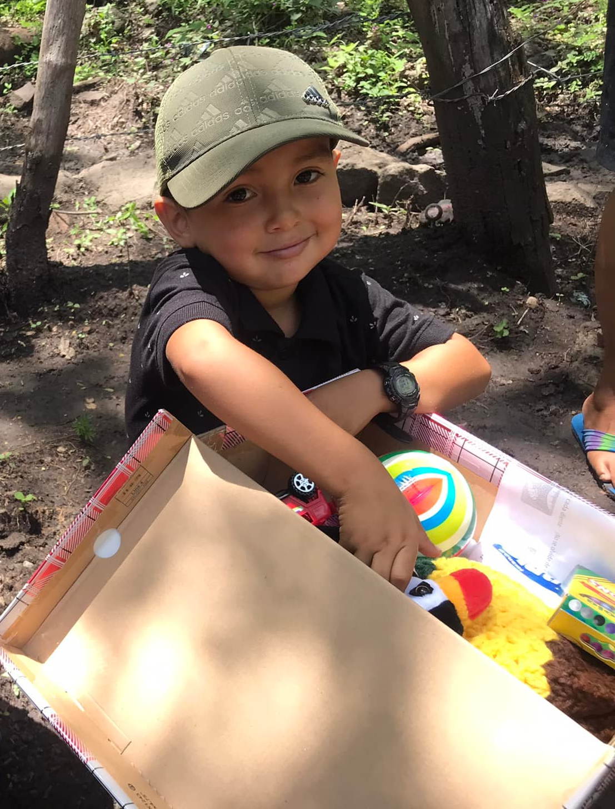
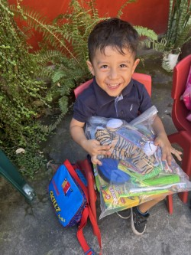
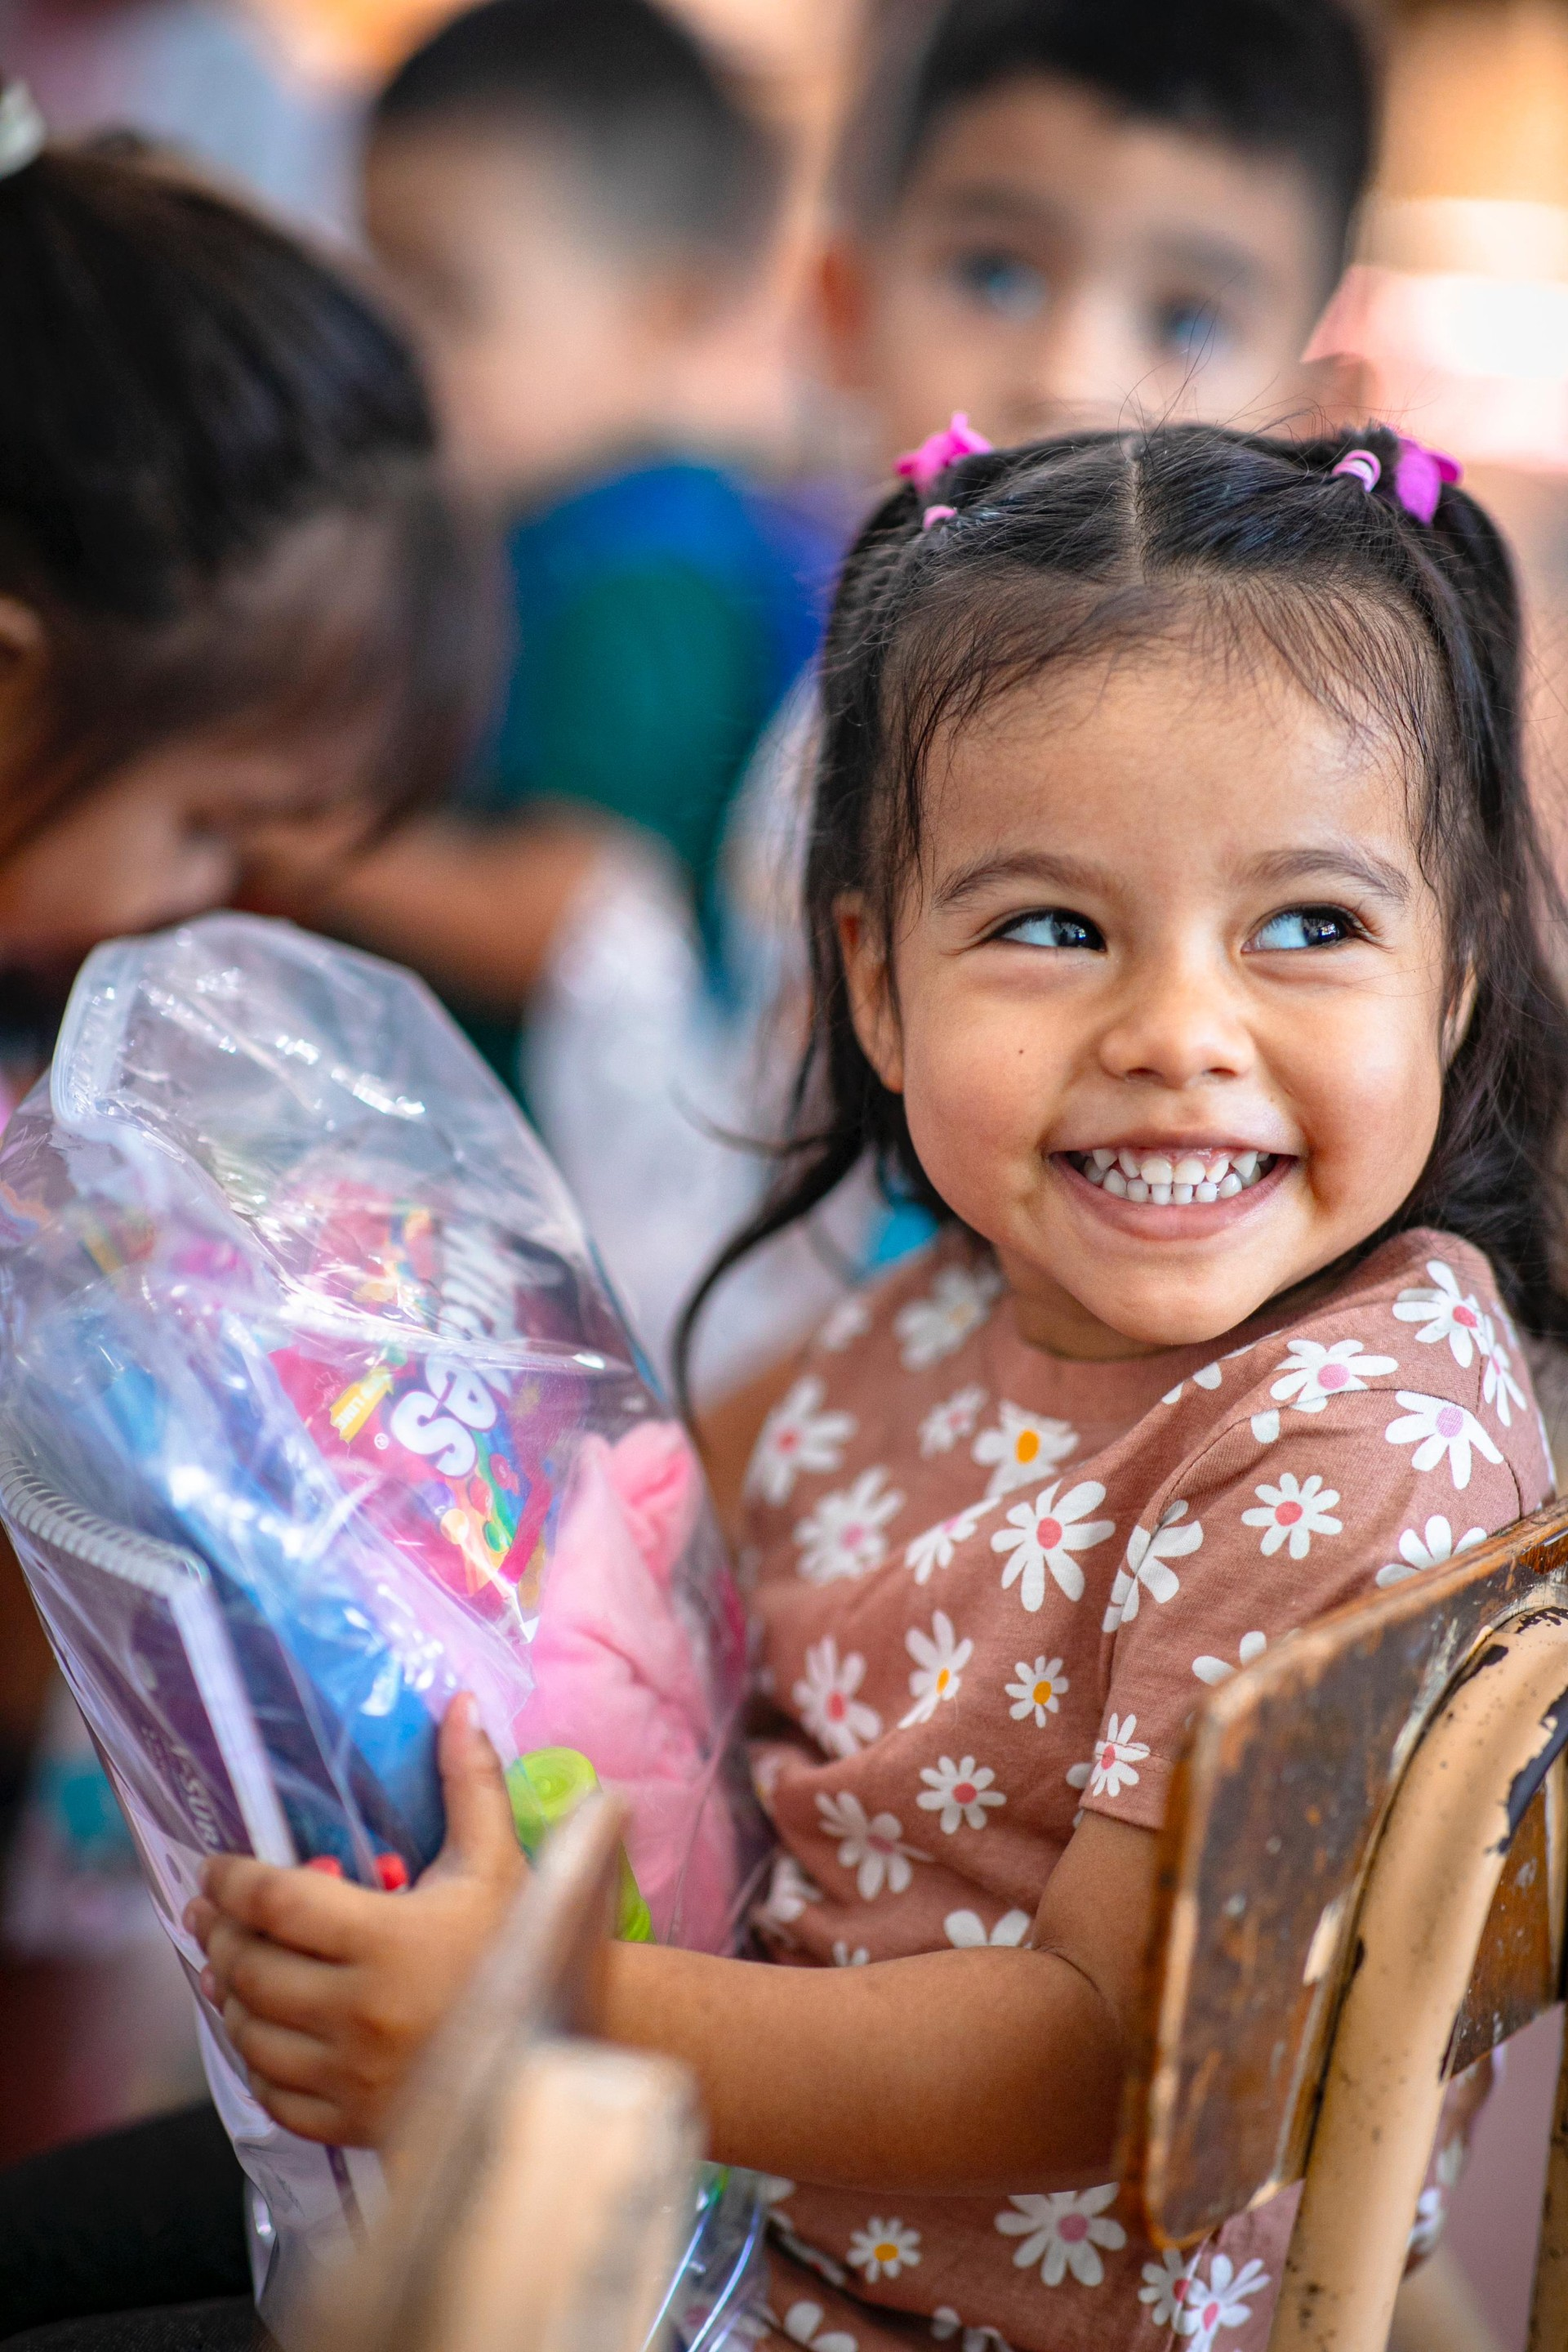
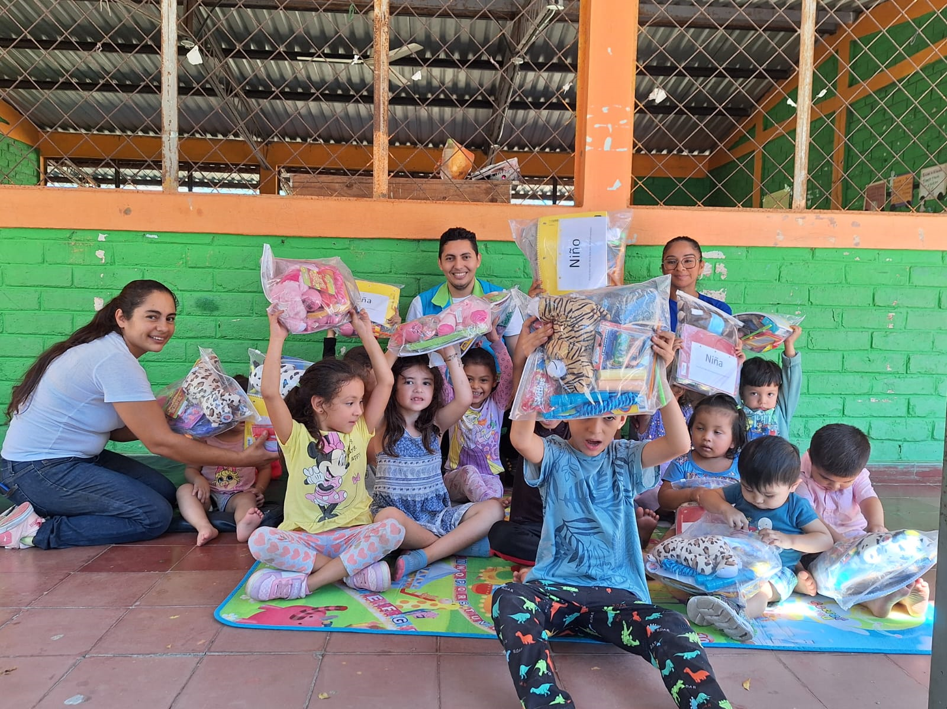
SMILES-2025
Smiles were sent to Nicaragua, Honduras, Haiti, Mexico and
El Salvador in 2024

Slide 2
ITEMS FOR SMILES-
School Supplies
1) 2 Pencils, 1 pencil sharpener, 1 Pen
2) Paper product notebook/coloring book
3) 1 set of colors (crayons, or markers, or colored pencils)
Personal Items
4) Toothbrush & toothpaste
5) A comb or hairbrush.
6) Girls: add hair clips, bows,
hair ties
Clothing
7) 1 Item of clothing (Flip Flops, shirt, pants, hats, etc)
Toys
8) 4 toys (Please do not include toys that require batteries, English instructions or are “Army” toys. Books should be bilingual or Spanish only.)
Candy
9) Top off your box with a snack bag of hard candy! (No chocolate, please!)
(PLEASE NOTE: Do not put soap or lotions in the Smiles and only hard candy, separately wrapped.)
A Smile for a Child. As we say every year, WORDS cannot truly express our gratitude for your continued support for this mission for Christ..
You can download and print the “Smiles” brochure from www.misionparacristo.com. You will also find a Smiles video to share on the website. Please email us at info@misionparacristo.com or call 318-560-2868 with your plans to participate.
AS WE ARE TRYING TO SEND SMILES TO 5 COUNTRIES; WE NEED YOUR HELP TO TELL OTHERS ABOUT THE JOY OF SMILES.
Again, we ask you to contact us to let us know you are doing Smiles-2025. Also, contact us when you have finished your Smiles at info@misionparacristo.com or call 318-560-2868 for pick-up plans, drop-off locations, or where you can send your Smiles. PLEASE GET IN TOUCH WITH US BY SEPTEMBER 1 SO WE CAN ARRANGE PICKUP. Special note: Smiles going to Highway needs to be there by September 1. Please get in touch with us for pickup and shipping locations. Please remember the $5 that helps cover the cost of shipping and distribution of the Smiles each year.
If you would like to contribute to more “Smiles” to be made, please send to Smiles, c/o Highway Church of Christ, 128 Highway Church Lane, Judsonia, AR 72081.
Misión Para Cristo is a registered 501c3 mission.

